Slide 1
Application Engineering and Development
Lab Session - 2

Slide 2
Agenda
Objective of Lab
Learning one to many relationship using referencing.
Learn use of JTable and JOptionPane.
Creating Vital Signs application for a patient in Java Swing

Slide 3
1
Objectives

Slide 4
Objectives
Learn how to store multiple vital signs in Vital Sign History(1:m relationship) .
Understand how to use JTable to display vital signs and delete vital sign if required.
Understand the use of JOptionPane.

Slide 5
2
Creating Model Classes

Slide 6
Create Model Classes
In order to create new classes follow the steps from lab 1 for creation of new project.
Create Vital Sign Class with different attributes like blood pressure, pulse, etc.
Create accessors and mutators for the class attributes.

Slide 7
What is Vital Sign?
Vital Sign is being used to capture a patient’s health status at a given time.
9/13/13

Slide 8
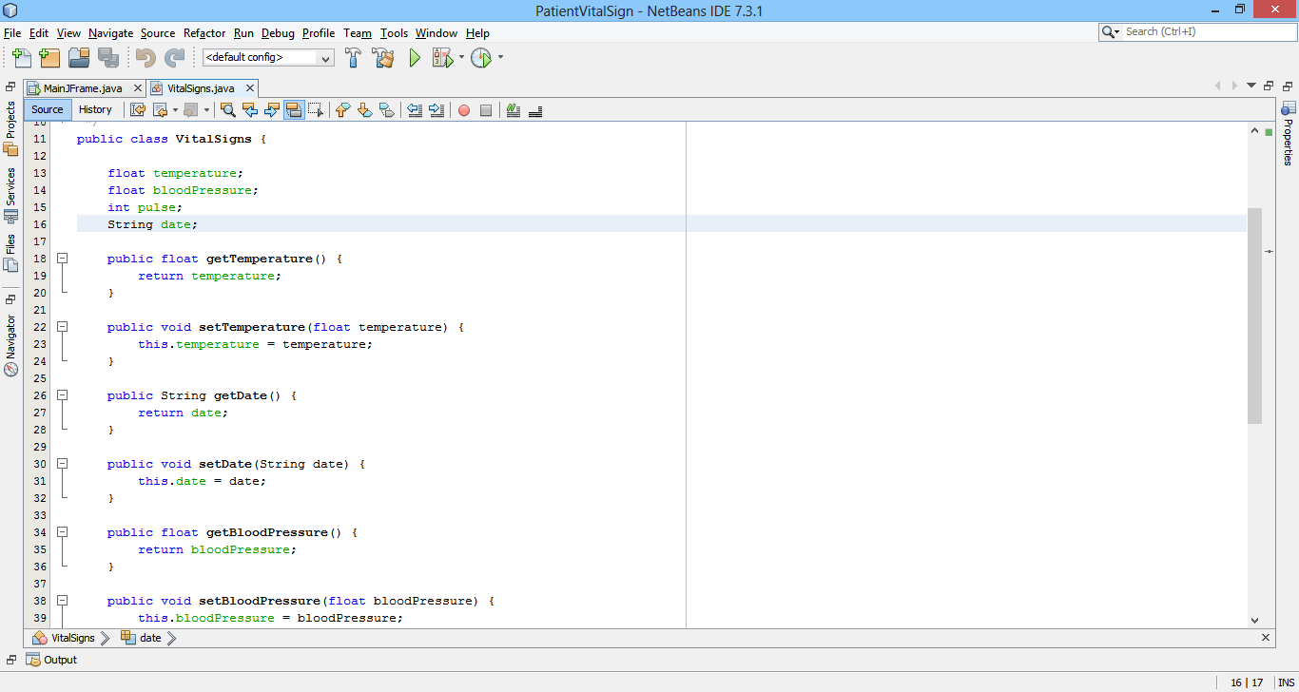

Slide 9
Create Model Classes
Create VitalSignHistory class that stores vital signs.
In order to store vital signs one needs to know the concept of ArrayList.
ArrayList<VitalSigns> vitalSignList;
vitalSignList = new ArrayList<>();

Slide 10
Create Model Classes
Add functions to add, delete vital signs.
Create accessors and mutators for the ArrayList.

Slide 11
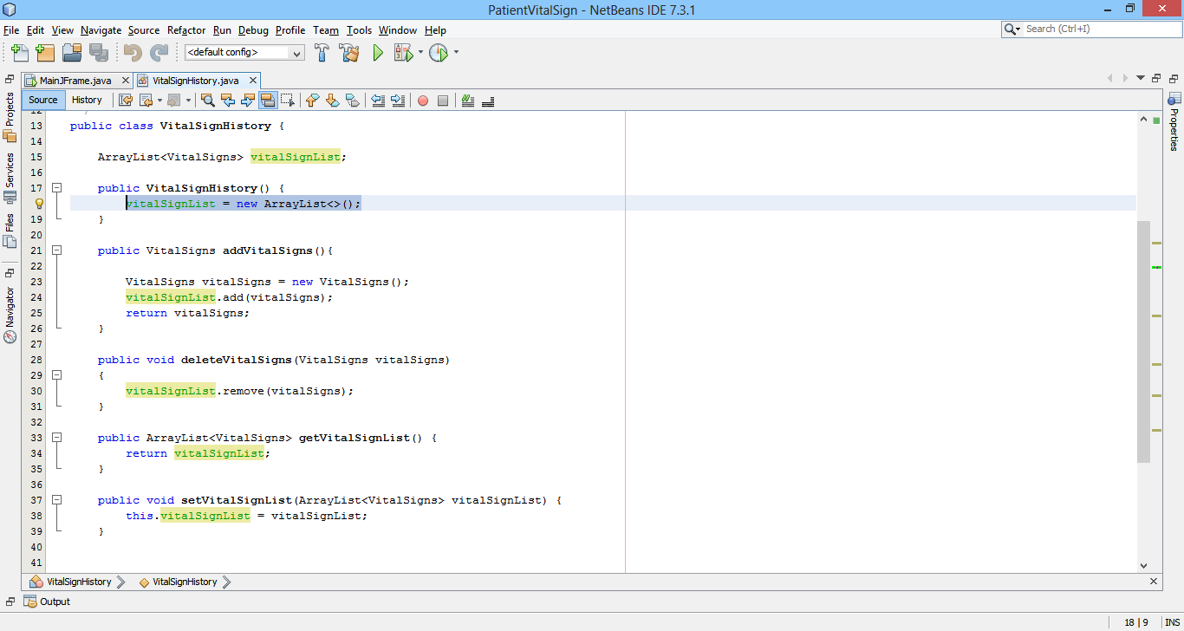

Slide 12
3
Creating GUI

Slide 13
Creating GUI
Create a JFrame form
Set the layout to Border Layout
Place the Split Pane onto form from Palette
Place JPanel on left and right section of the split pane
Place create and view vital sign buttons on the left panel.
If any doubt refer lab 1 presentation

Slide 14
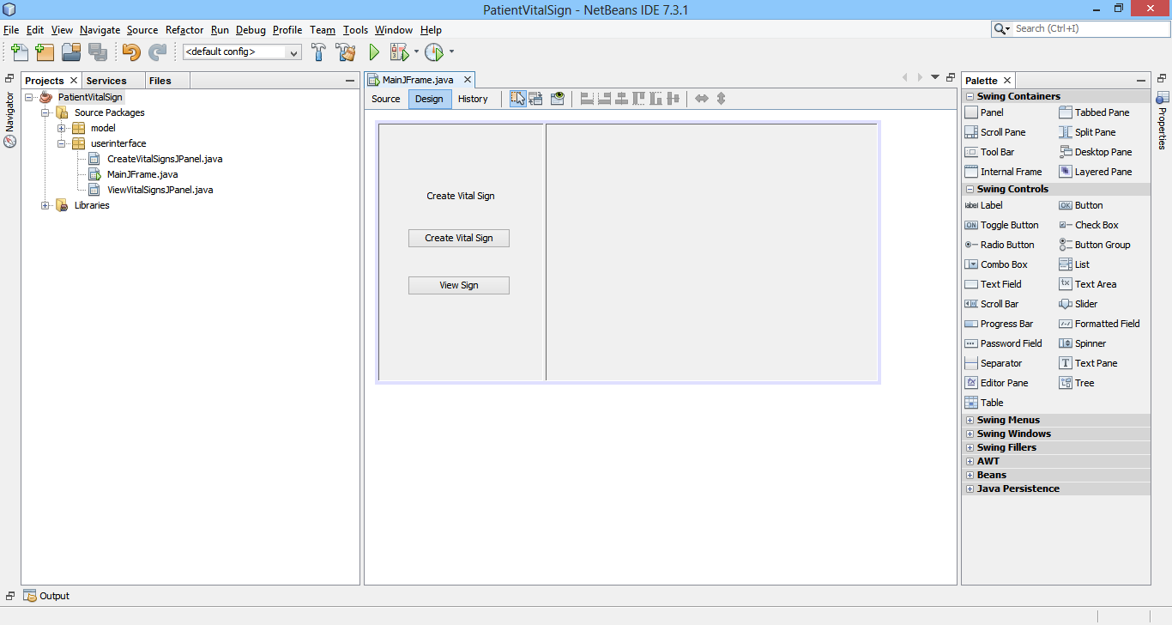

Slide 15
Understanding JTable
In swings controls section on the right drag the Table icon on to the view panel
Right Click on to the table for Table Contents
You will see three sections table model, columns and rows
Keep the table model value as user specified
Columns can be used to display the attribute values of a class.
In rows section keep initial number as 0

Slide 16
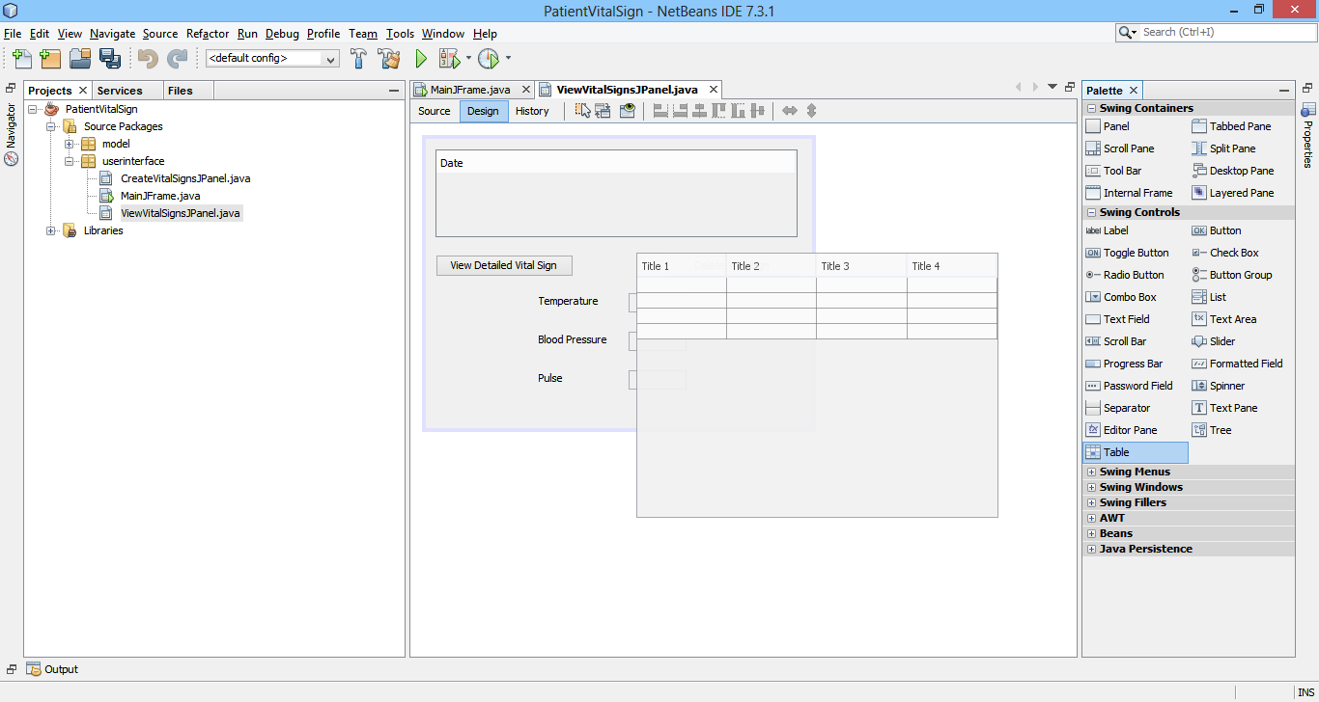

Slide 17
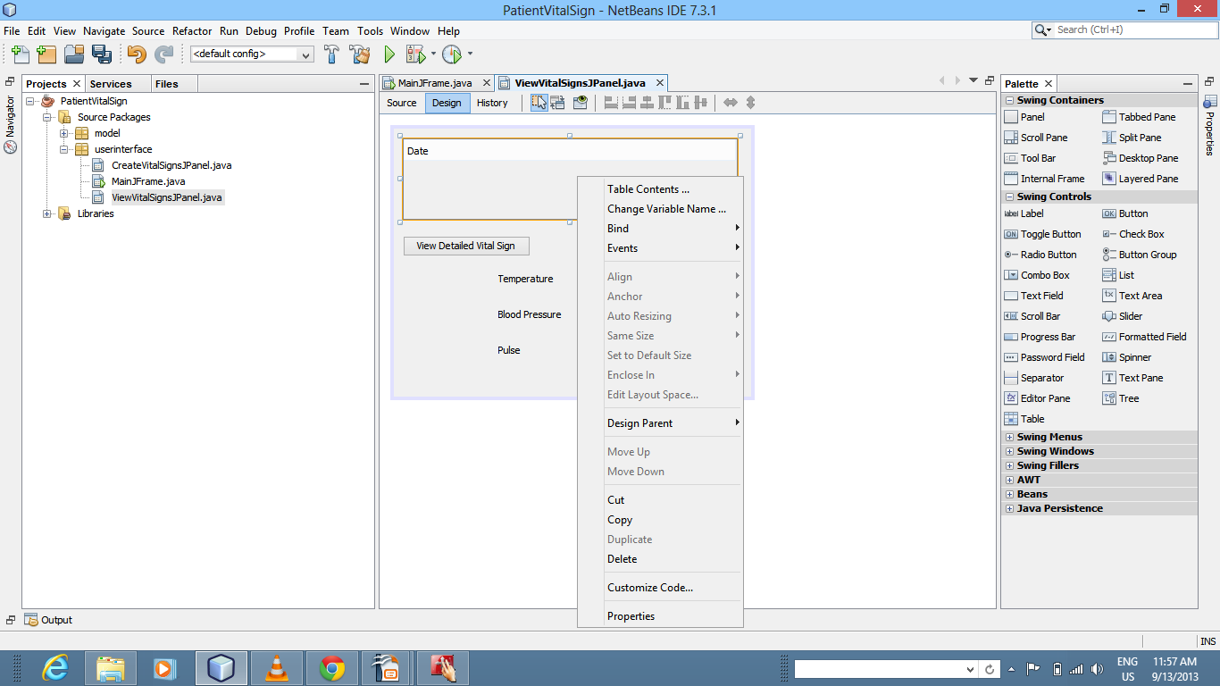

Slide 18
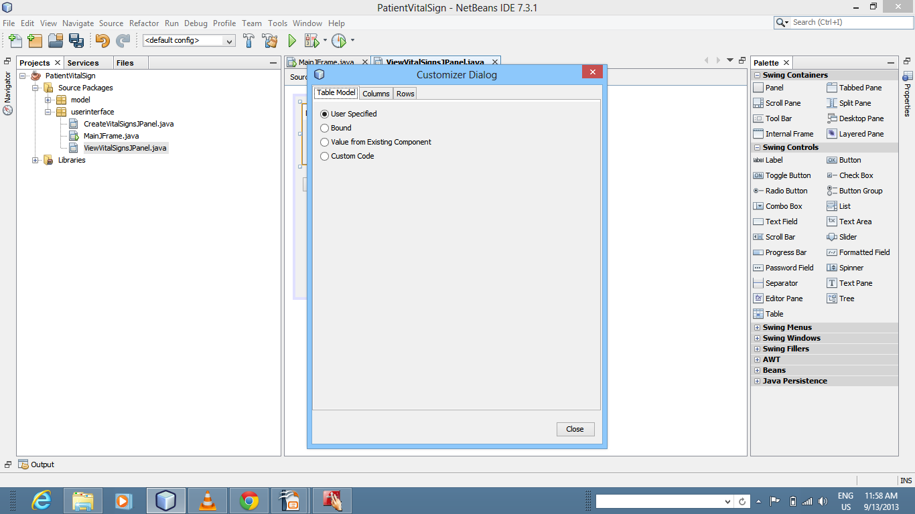

Slide 19
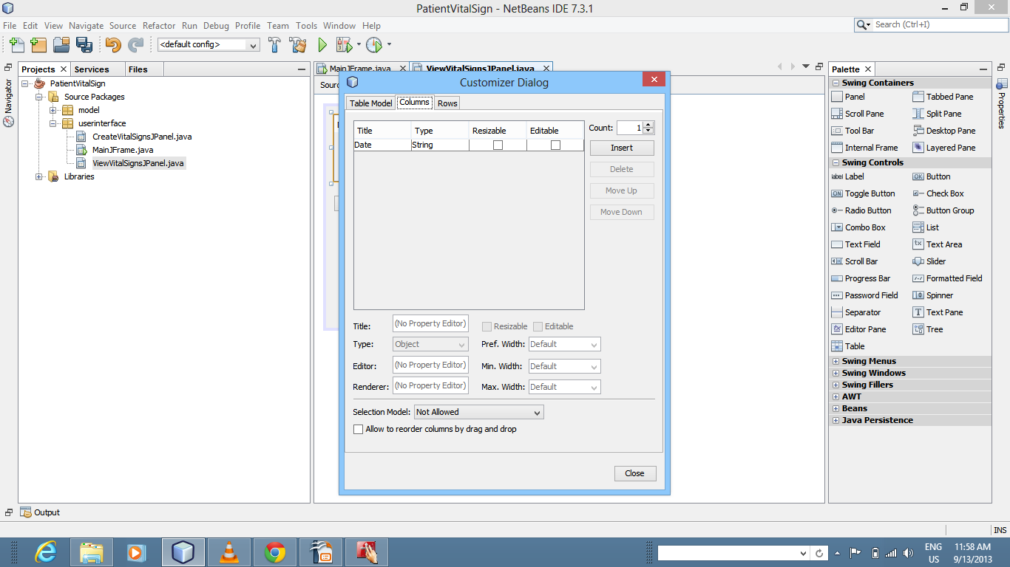

Slide 20
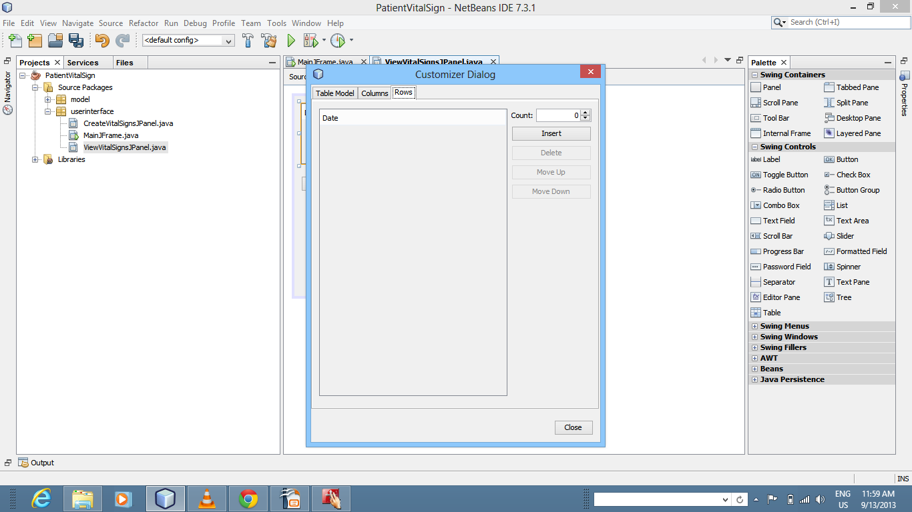

Slide 21
Understanding JOptionPane
JOption Pane is used to show a dialog box
It can be used to define only a message or one can assign actions based on user actions.
int dialogButton = JOptionPane.YES_NO_OPTION;
int dialogResult = JOptionPane.showConfirmDialog (null, "Would You Like to Delete Vital Sign?","Warning",dialogButton);
if(dialogResult == JOptionPane.YES_OPTION)
{
//Perform actions you want
}

Slide 22
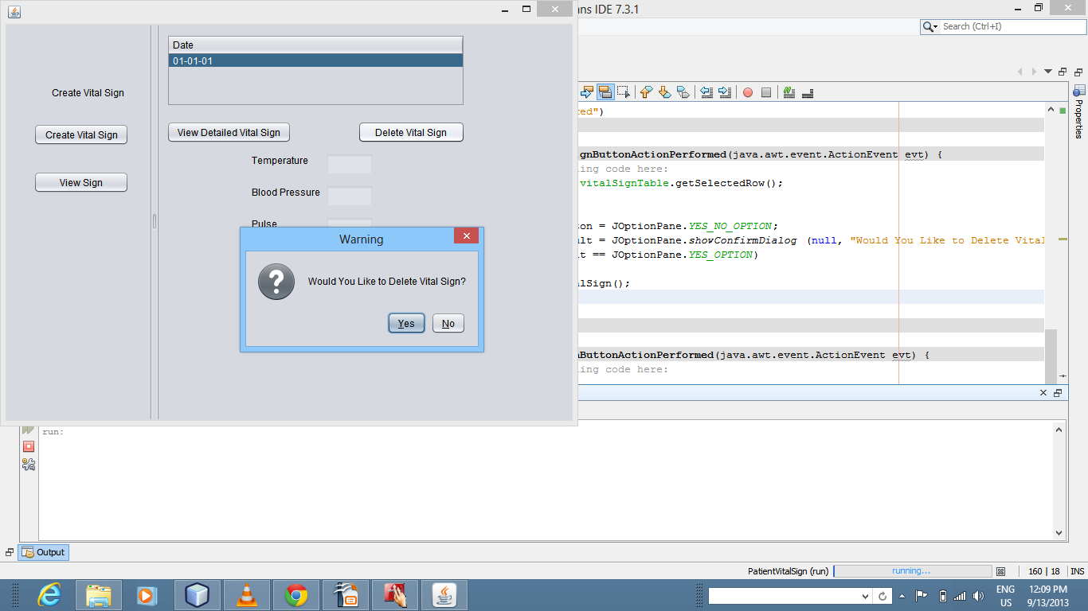

Slide 23
4
Overview

Slide 24
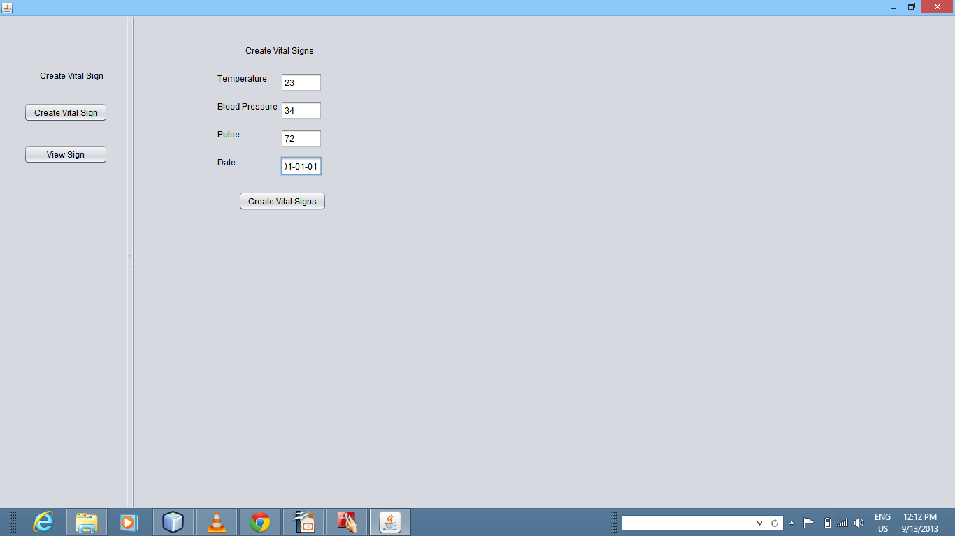

Slide 25
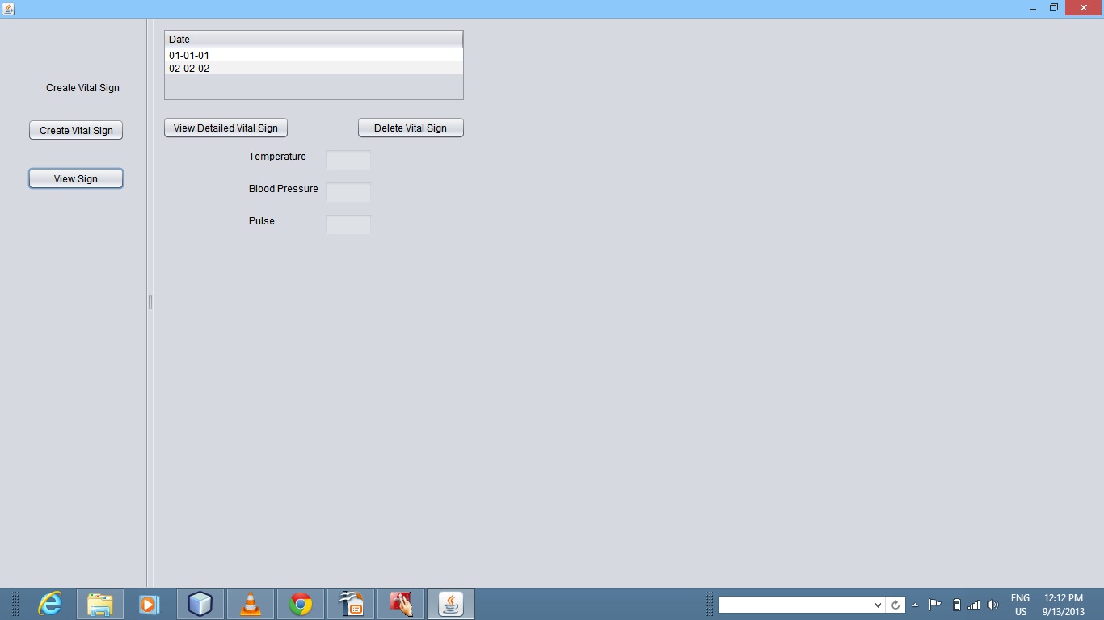

Slide 26
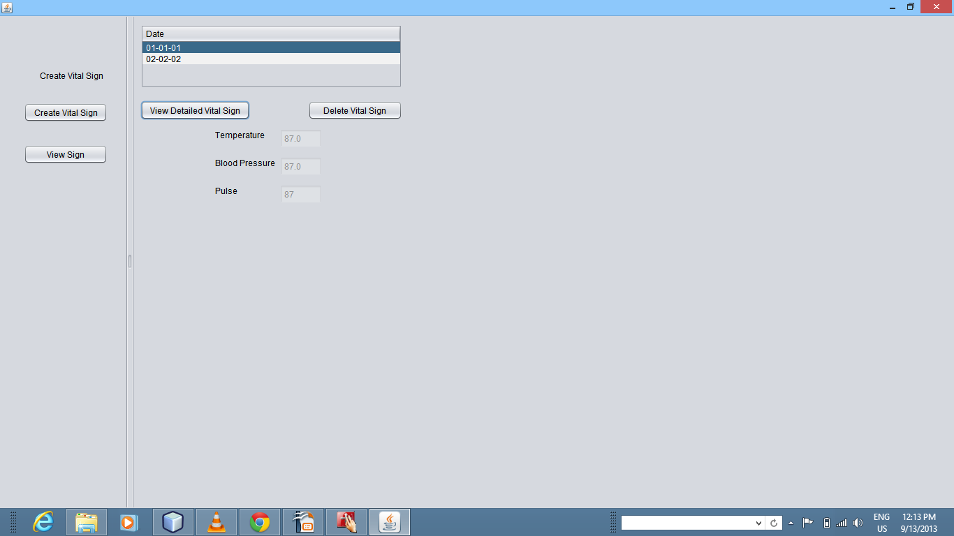

Slide 27
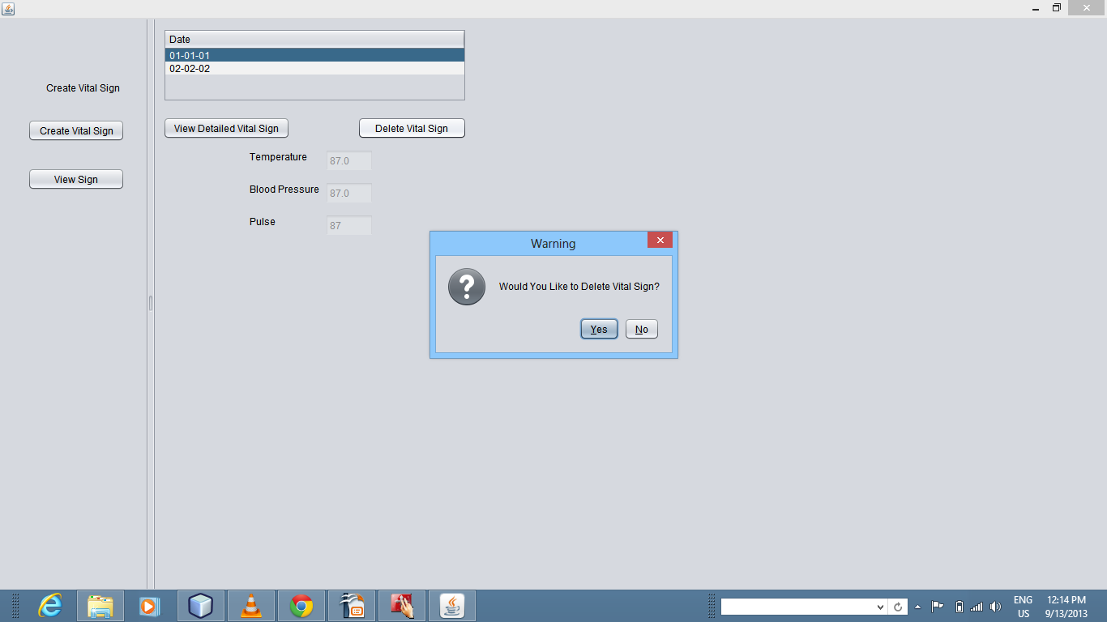

Slide 28
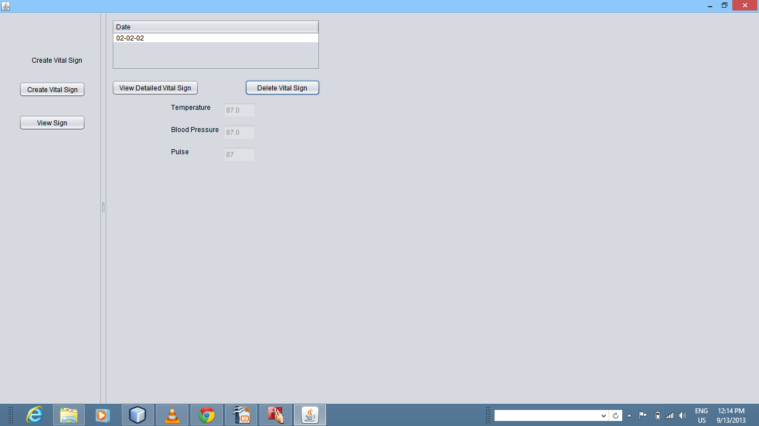

Slide 29
Note For Students
This is just a reference material
For all the assignments post assignment 1, you will need to validate all your input fields
For example check if the value entered in the number field is actually an integer, check for null values, etc

